Slide 1
Sales Data Analysis using MS SQL
Analyst : Dutse Samuel Yaula
1st April, 2023

Slide 2
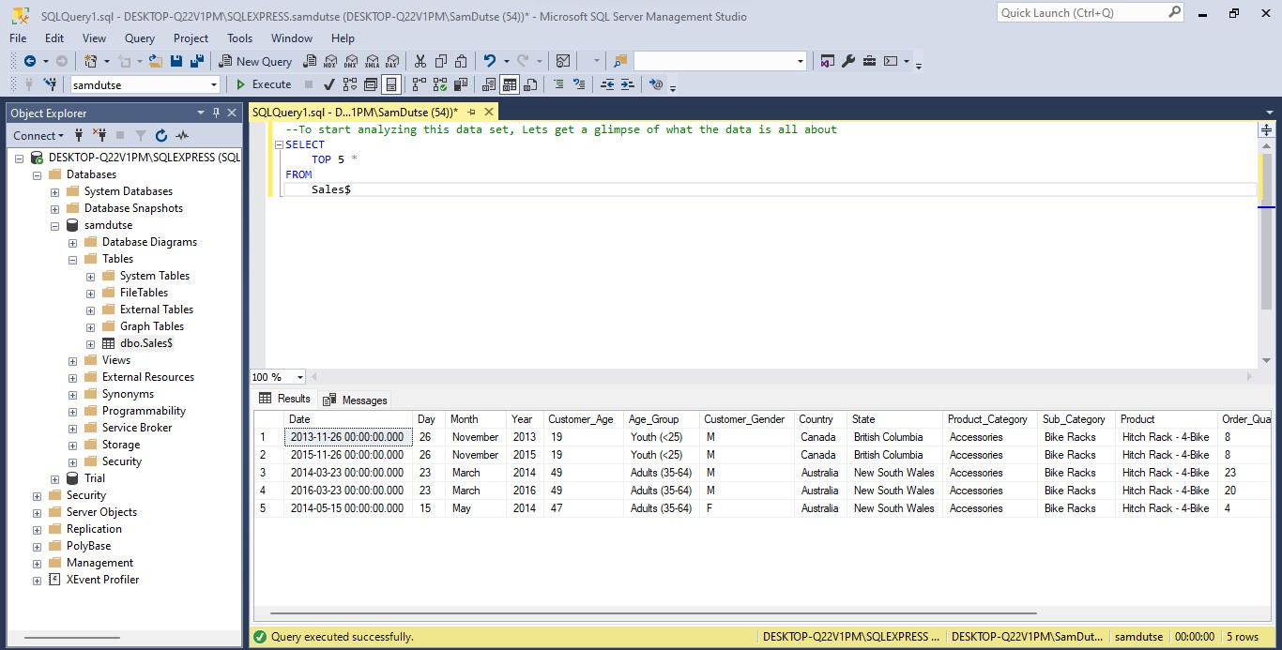
Viewing the TOP 5 rows of the data to have a glimpse of the content

Slide 3
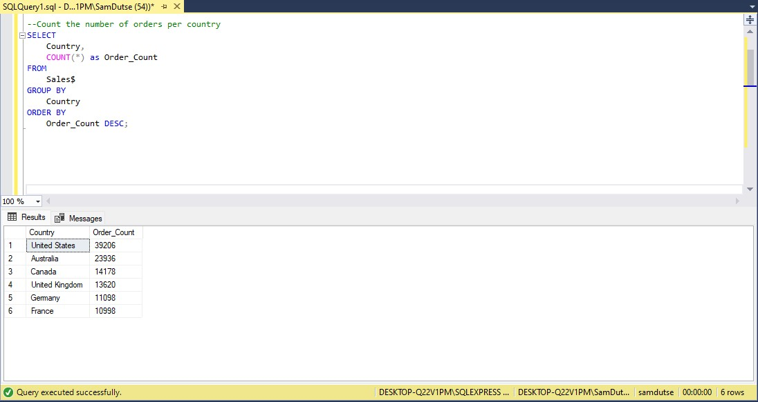
Counting the number of orders per country

Slide 4
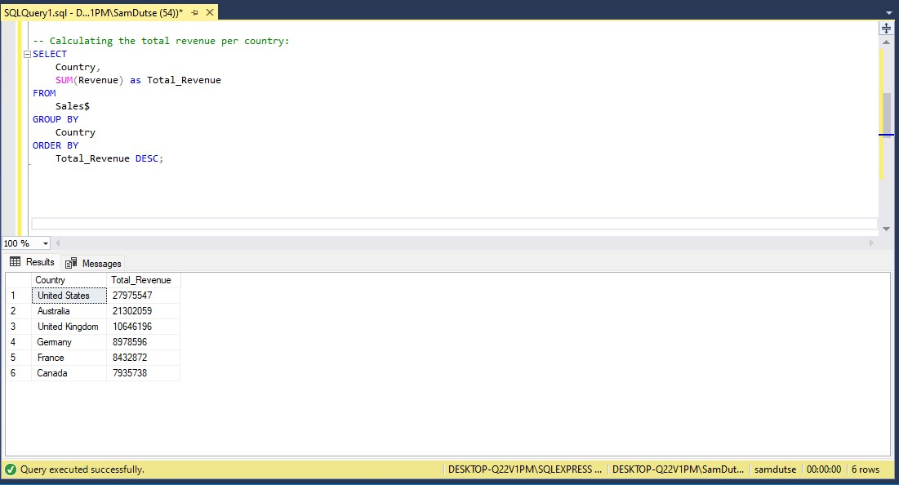
Total Revenue by country per Country

Slide 5
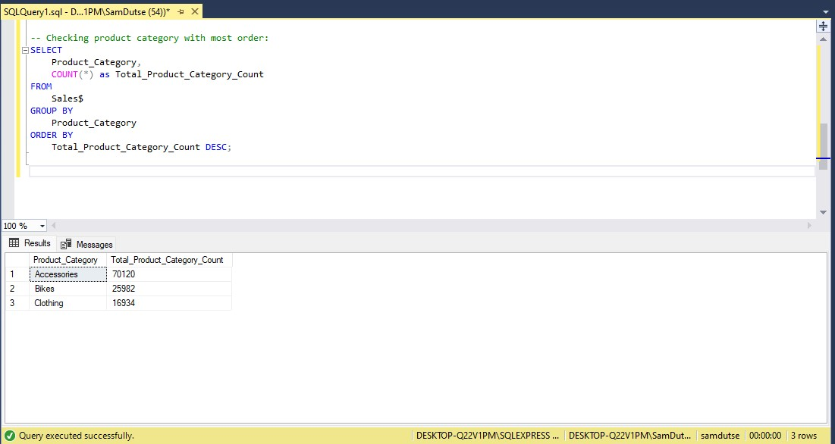
Total Product category Count

Slide 6
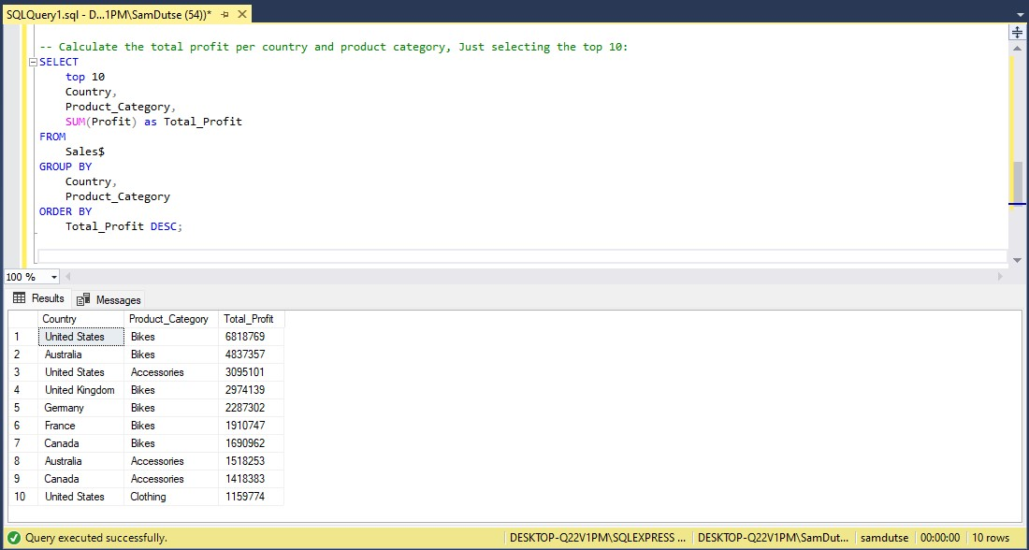
Selecting the top 10, total profit per country and product category

Slide 7
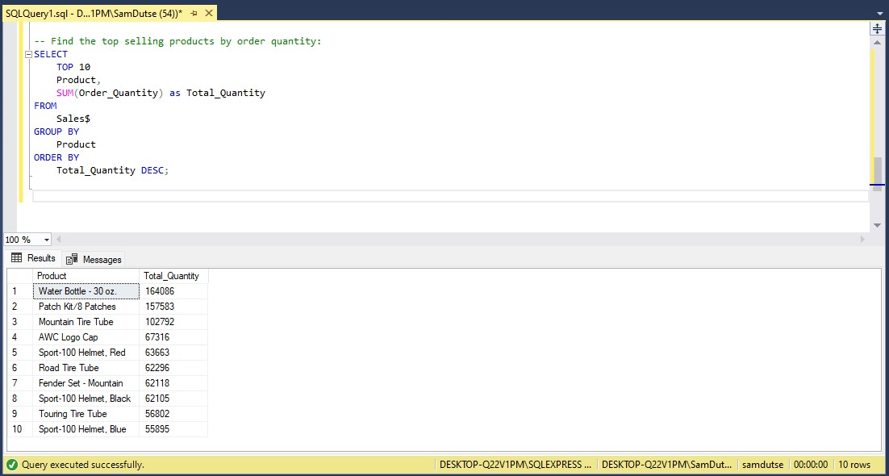
Finding the top selling products by order quantity

Slide 8
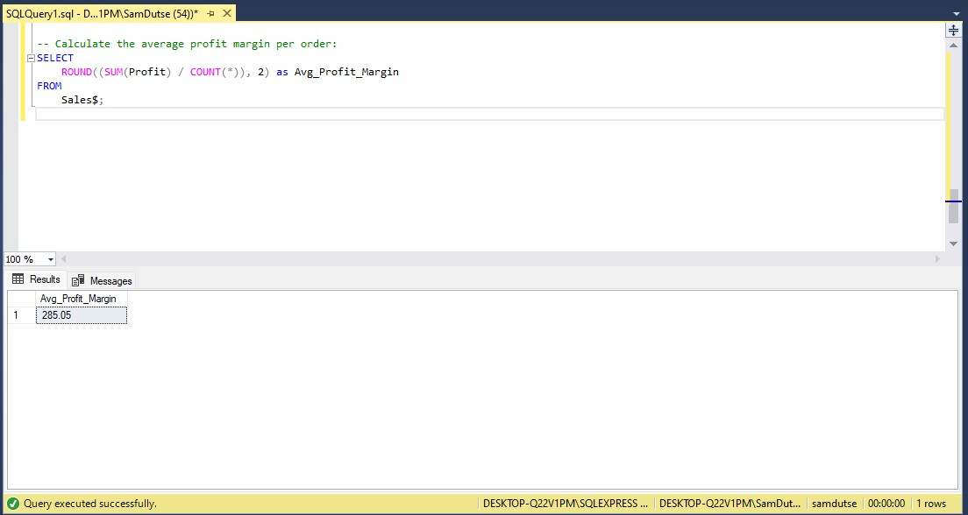
Calculating the average profit margin per order

Slide 9
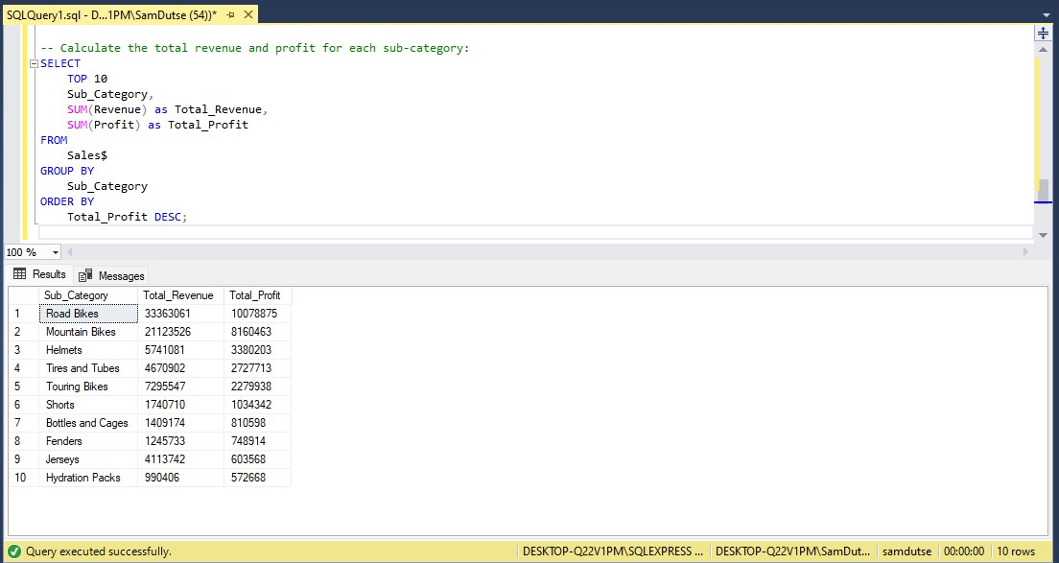
Calculating the top 10 Total revenue and profit for each sub-category

Slide 10
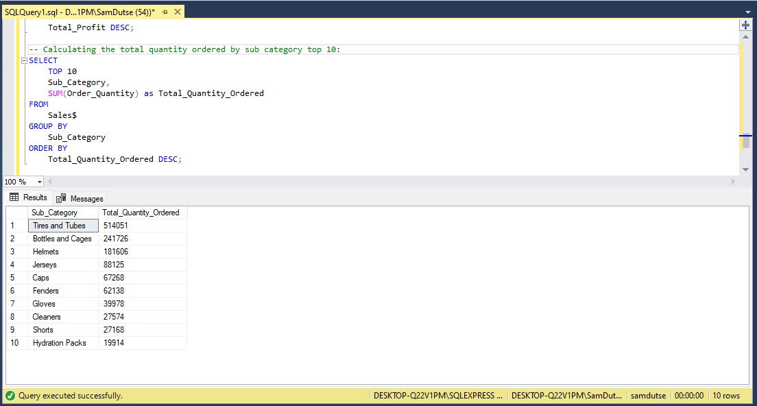
Calculating the total quantity ordered by sub-category, Selecting the top 10

Slide 11

Hi! My name is Samuel Yaula Dutse
Where to contact me:
Linkedin: https://linkedin.com/in/samdutse
Email: samuelyauladutse@gmail.com
Github: https://github.com/SamDutse
Medium: https://medium.com/@samuelyauladutse
Twitter: https://www.twitter.com/samdutze

